Slide 1
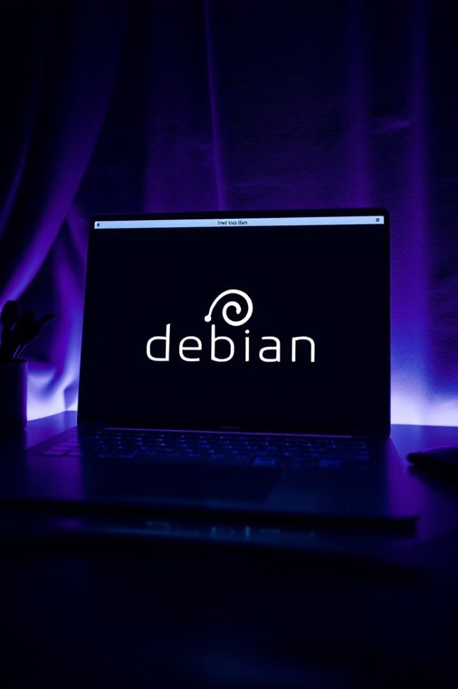
Preparing a Debian Virtual Machine
Setting up a Debian virtual machine requires careful preparation and configuration. For optimal performance, you'll need at least 4 GB RAM and 20 GB of available disk space, with VirtualBox and its Extension Pack installed on your host machine.
The virtual machine should be configured with the name "sae203", Linux type, Debian 12 64-bit version, 2048 MB RAM, and a 20 GB hard drive on a single partition. Remember to check "Skip Unattended Installation" to maintain control over the setup process.
When installing the operating system, you'll configure the machine name as "serveur" and select packages including the MATE desktop environment, web server, SSH server, and standard system utilities.

Slide 2
Git GUI Tools: Git-GUI Overview
Git-GUI is a lightweight graphical tool bundled directly with the Git distribution. It's specifically designed to simplify staging and committing operations, providing an intuitive interface for managing changes to your repository.
This native Git tool offers several key features including visualization of modified and untracked files, granular selection of file sections for staging (partial staging), and creation of commits with support for multiline messages. It also provides a quick preview of changes before committing.
Launching Git-GUI is straightforward: open a terminal, navigate to your local Git repository, and execute the command "git gui". Advanced launch options include "git gui citool" to directly open the commit interface and "git gui blame" for the blame tool.
Main Features
Launch Options
Advantages
Interface dedicated to staging and committing changes
git gui: Standard interface
Lightweight alternative to complex GUIs
git gui citool: Direct commit interface
Native Git solution
Visualization of modified and untracked files
git gui blame: File blame tool
Ideal for basic Git operations
Granular selection of file sections for staging

Slide 3




Choosing GitKraken: Installation and Rationale
After evaluating various Git GUI tools, GitKraken emerged as the preferred choice for several compelling reasons. Its popularity and high ratings in the developer community, combined with its modern and intuitive interface, make it particularly effective for visualizing branches and repository history.
A significant advantage for students is free access to the Pro version through the GitHub Student Developer Pack, unlocking premium features at no cost. Additionally, GitKraken's cross-platform compatibility ensures seamless collaboration across Windows, macOS, and Linux environments.
Activate GitHub Student Pack
Visit education.github.com to activate the student benefits
Visit GitKraken Website
Go to gitkraken.com to access the official download page
Download Installer
Get the appropriate installer for your operating system (approx. 100 MB)
Run Installation
Follow the on-screen instructions to complete setup

Slide 4
Comparing Git GUI Tools
When evaluating Git graphical interfaces, it's essential to understand how they compare in functionality, ease of use, and performance. GitKraken offers significant advantages over native Git tools like Gitk and Git-GUI, though each has its place in a developer's toolkit.
While native tools provide basic functionality with minimal resource usage, GitKraken delivers a more comprehensive and intuitive experience at the cost of higher system requirements. The right choice depends on your specific needs, workflow complexity, and available resources.
GitKraken vs Gitk
GitKraken vs Git-GUI
GitKraken vs Command Line
Modern UI vs traditional interface
Comprehensive tool vs commit-focused utility
Visual workflow vs text commands
Interactive graph vs static visualization
Guided operations vs manual syntax
Integrated actions vs view-only history
Repository-wide management vs file-level operations
Integrated help vs documentation lookup
Higher resource usage vs lightweight operation
Integrated platform tools vs standalone functionality
Resource-intensive vs minimal footprint
Steeper learning curve vs immediate usability

Slide 5



GitKraken's Advanced Features
GitKraken distinguishes itself through a combination of intuitive design and powerful functionality that streamlines Git workflows. Its graphical representation of branches with color-coding and drag-and-drop capabilities makes complex Git operations more accessible to users of all experience levels.
Beyond basic Git operations, GitKraken offers seamless integration with major platforms like GitHub, GitLab, and Bitbucket, allowing users to manage pull requests and issues without switching applications. The profile system enables easy management of multiple Git accounts, while features like WIP (Work In Progress) provide flexible options for saving changes.
Intuitive User Interface
Advanced Features
Productivity Enhancements
Color-coded branches, drag-and-drop actions, customizable themes, and contextual tooltips create a user-friendly experience
Platform integrations, profile management, WIP functionality, submodule support, built-in terminal, and automatic repository detection
Customizable keyboard shortcuts, interactive timeline, integrated notifications, visual merge tool, and powerful search capabilities

Slide 6




GitKraken vs Command Line: Strengths and Weaknesses
The choice between GitKraken and the Git command line represents a fundamental tradeoff between visual intuition and granular control. While GitKraken excels at making complex Git operations more accessible through its graphical interface, the command line offers unparalleled flexibility and performance for experienced users.
GitKraken's visual representation of branches and history provides immediate context that can be difficult to grasp from text output alone. However, the command line's scriptability and minimal resource requirements make it indispensable for certain workflows, particularly in automated environments or when working with remote servers.
Visualization
GitKraken provides clear visual context while CLI requires mental mapping
Learning Curve
GitKraken offers intuitive discovery while CLI demands memorization
Performance
CLI excels with minimal resource usage while GitKraken requires more memory
Automation
CLI enables powerful scripting while GitKraken focuses on manual operations

Slide 7






GitKraken's Limitations and Drawbacks
Despite its many advantages, GitKraken is not without limitations that users should consider before fully committing to the platform. Understanding these drawbacks helps set realistic expectations and determine whether GitKraken is the right tool for your specific needs and environment.
The most notable concern is resource consumption, as GitKraken requires significantly more memory and CPU power than lightweight alternatives like the command line or native Git tools. This can be particularly problematic on older hardware or when working with very large repositories.
Resource Consumption
Higher memory and CPU usage than command-line tools
Free Version Limitations
Key features restricted to Pro version (though free with Student Pack)
Interface Dependency
May lead to weaker understanding of underlying Git commands
For students with access to the GitHub Student Developer Pack, the Pro version limitations are mitigated. However, relying exclusively on GitKraken's visual interface may potentially hinder the development of a deeper understanding of Git's command structure and operations, which could be valuable knowledge in environments where GUI tools aren't available.

Slide 8

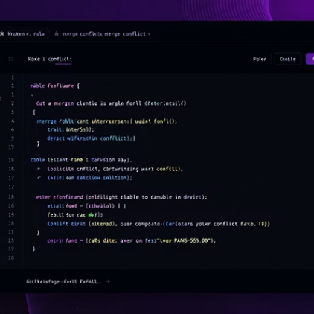

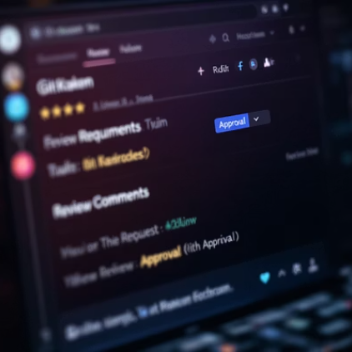
User Experience and Team Feedback
After several weeks of intensive use in university projects, GitKraken demonstrated significant value in improving branch management and repository understanding. Team members with limited Git experience quickly became productive thanks to the intuitive interface, reducing the learning curve typically associated with version control systems.
The clear visualization of branches helped prevent merge confusion, while the integrated GitHub functionality streamlined pull request management without requiring context switching between applications. Perhaps most notably, the visual merge conflict resolution tool simplified what is traditionally one of Git's most challenging aspects.
Team members particularly appreciated how GitKraken's visual representation helped clarify the relationship between branches and commits, making it easier to understand the project's evolution and structure. This improved comprehension translated to more effective collaboration and fewer version control errors.

Slide 9








Balancing Power and Usability in Git Tools
GitKraken represents an excellent compromise for developers seeking to combine Git's power with enhanced usability. While native tools like Gitk and Git-GUI offer basic functionality with minimal system impact, GitKraken's intuitive interface and advanced capabilities significantly reduce Git's learning curve.
For collaborative projects, GitKraken accelerates workflow and reduces common command-line errors. The clear visualization of history and branches promotes better understanding of project structure and code organization, benefiting both novice and experienced developers.
Learning
Understanding
Visual interface reduces Git's learning curve
Clear visualization improves repository comprehension
Management
Collaboration
Advanced features simplify complex Git operations
Streamlined workflows enhance team productivity
While GitKraken's resource requirements and potential dependency on its interface are valid concerns, these disadvantages are largely offset by its strengths, especially for students with access to the Pro version through the GitHub Student Developer Pack.

Slide 10



Resources for Further Learning
To maximize your experience with Git and GitKraken, numerous resources are available for continued learning and reference. The official documentation provides comprehensive guides for both beginners and advanced users, covering everything from basic operations to complex workflows.
Students should take advantage of the GitHub Student Developer Pack, which includes free access to GitKraken Pro along with many other valuable developer tools. This resource significantly enhances your learning experience while saving on costs typically associated with professional development tools.
Official Documentation
Comprehensive guides and tutorials from GitKraken and Git
GitKraken Documentation
Git Documentation
Student Resources
Free access to professional tools for educational purposes
GitHub Student Developer Pack
Tutorial Videos
Visual learning resources for Git and GitKraken
GitKraken YouTube channel
Git tutorial series

